Slide 1
HOW TO SET UP TEAMS ATUO-ATTENDANT

Slide 2

Auto Attendant Explanation
Auto Attendants:
Purpose: Auto attendants serve as virtual receptionists. They direct callers based on input to menu options.
Call Routing Options: Callers can be directed to: Specific people within your organization. Call queues where they wait for the next available agent. External phone numbers. Other auto attendants. Voicemail. Different routing options can be set for business hours, off hours, and holidays.
Menu Prompts: Created using text-to-speech or recorded audio files. Speech recognition allows hands-free navigation.
Language and Time Zone: Each auto attendant has a specific language and time zone. Multiple auto attendants can accommodate different languages or regions.
Operator Configuration: Configure an operator for each auto attendant. Operators assist callers by connecting them to specific people in your organization.
Directory Search: Callers can search your organization’s directory by name or extension number. Specify available users within the auto attendant (known as dial scope).
Access Methods: Internal callers (using Teams) reach auto attendants via the assigned resource account. External callers dial the phone number assigned to the resource account or use web-based click-to-call.

Slide 3
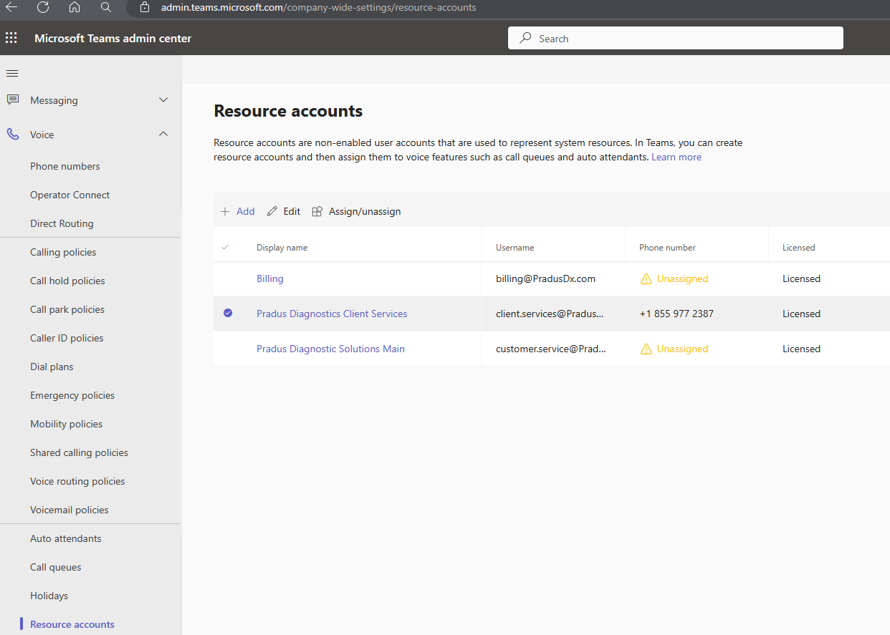
STEP 1: SET UP A RESOURCE ACCOUNT
Go to Teams Admin Center (teams.microsoft.com)
Go to Voice
Go down to Resource Accounts
Click + Add.
Type in what you'd like the display name to be. For this one we used Pradus Diagnostics Client Services.
Type in the Username you'd like to use. This creates a user account. For this one we used client.services@pradusdx.com.
Select a Resource account type. For this one we choose Auto Attendant as we are setting up Auto Attendant.
Click Save.

Slide 4
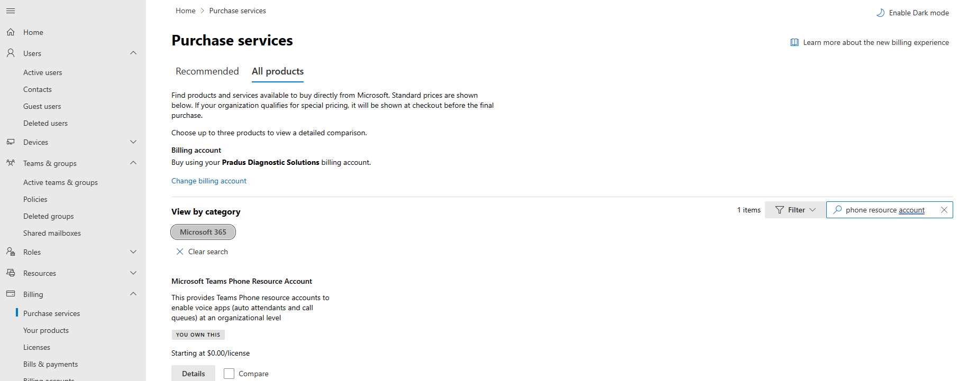
STEP 2: Go to the Admin Center - Purchase Services
Go to the Admin Center (admin.microsoft.com)
Go down to billing and select purchase services.
Filter results by searching for Phone resource account.
Purchase the Microsoft Teams Phone Resource Account.

Slide 5
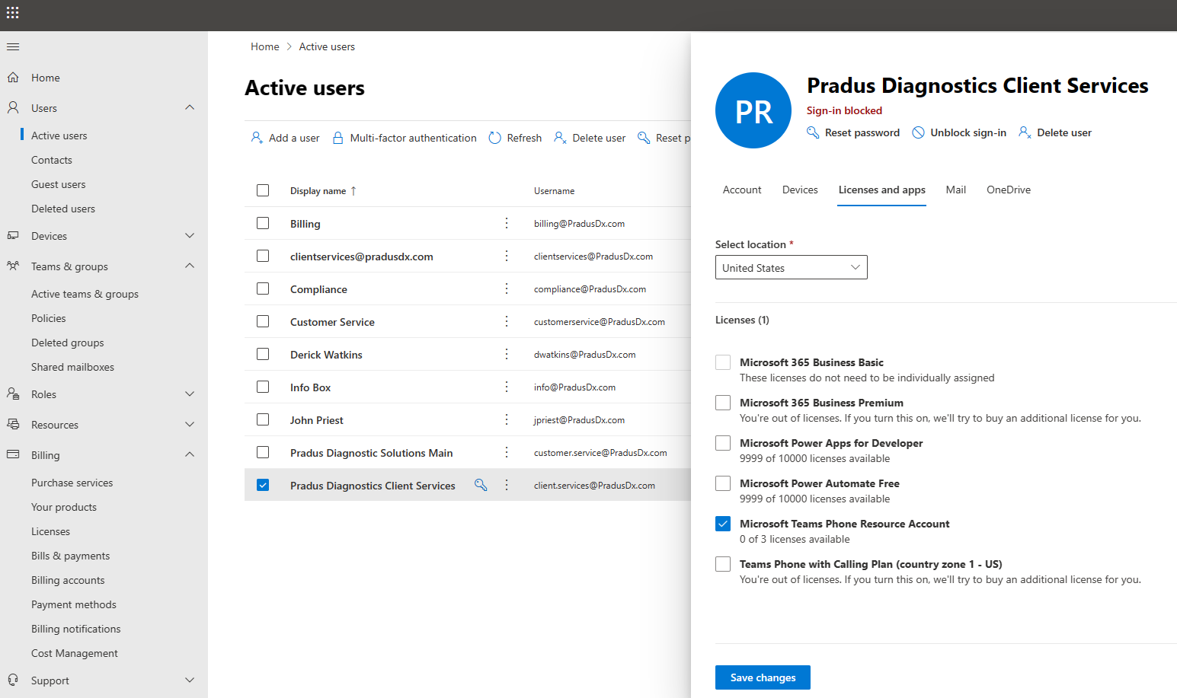
STEP 3: Admin Center - Activate Users
Stay in the Admin Center (admin.microsoft.com)
Go to Active Users.
Select or Add a new user. For the purpose of this set up I selected Pradus Diagnostics Client Services.
Go to Licenses and apps within the user setup and choose the Microsoft Teams Phone Resource Account license you created in Step 2.
Click Save changes.

Slide 6
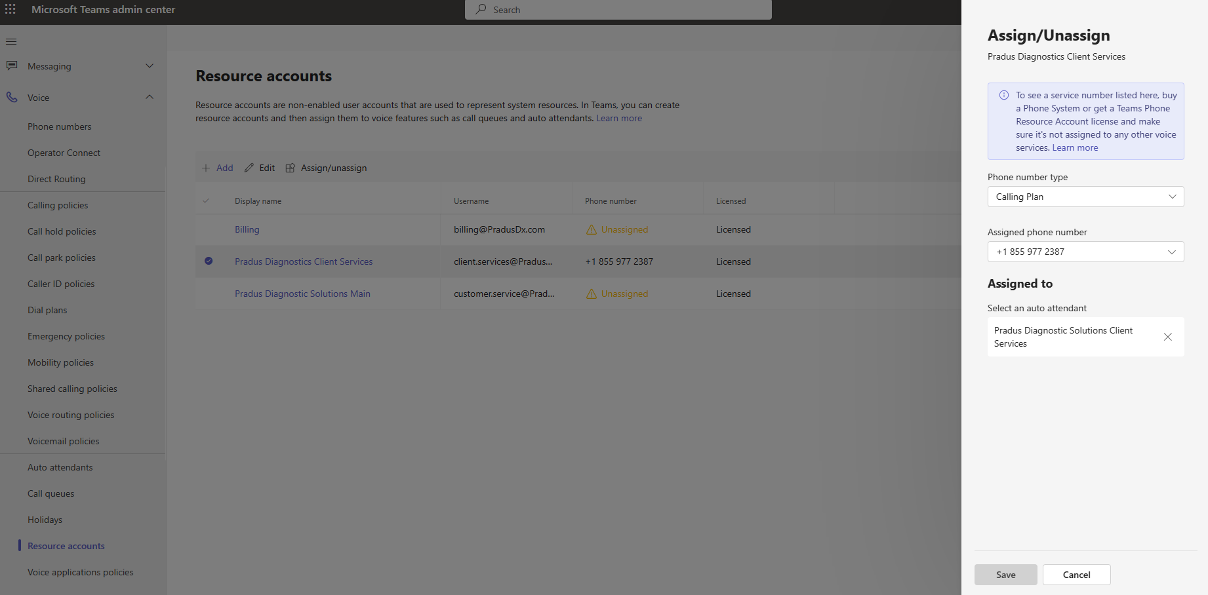
STEP 4: Teams Admin - Set up Resource Account
Go back to the Teams Admin Center (teams.microsoft.com)
Go to Resource accounts.
Select the account you are setting up. For this set up I choose Pradus Diagnostics Client Services.
Click Assign/unassign.
Choose Phone number type, calling plan.
Choose assigned phone number, the number you set up for this account.
Click Save.

Slide 7
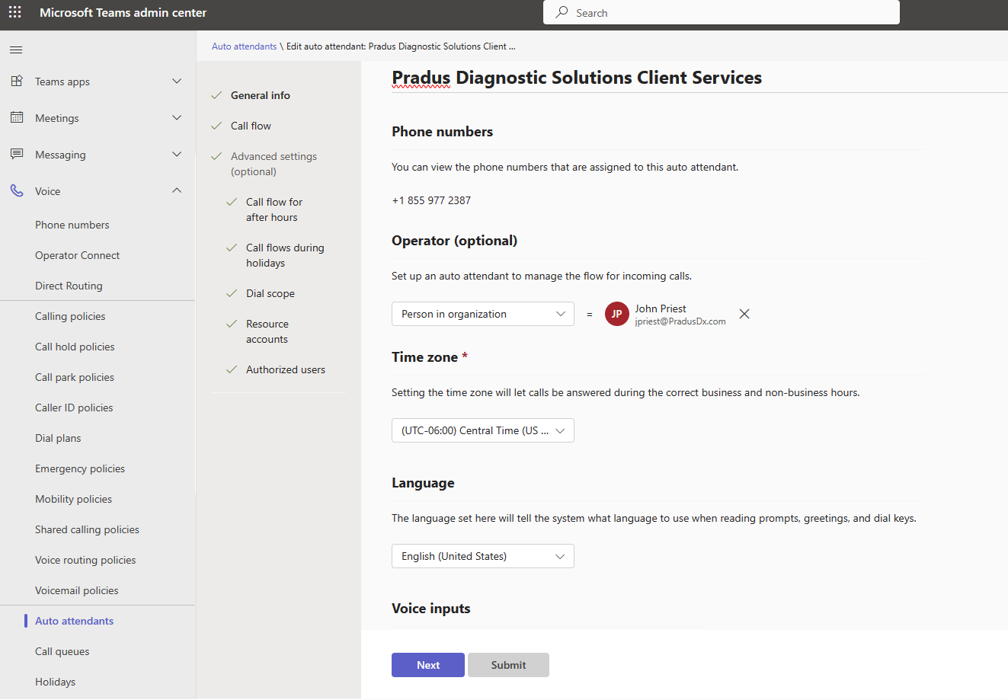
STEP 5: Teams Admin - Set up Auto Attendant
Stay in Teams Admin Center (teams.microsoft.com)
Go to Voice, Auto attendants.
Select + Add.
On General info tab, add what you want the auto attendant to be named. For this set up I choose Pradus Diagnostic Solutions Client Services. Choose phone number that you have been setting up for this purpose. Select an operator, select a time zone, select a language, and select yes or no to allow voice inputs or not.
On the call flow tab, fill in your greeting options, your call routing options, play an audio file or type a greeting message for the call routing. Set up your Dial Key and Voice Command Menu options.
As the business I am setting up is open 24/7 we did not set up the call flow after hours or call flows during holidays.
On the Dial scope tab, choose which users you would like to include or exclude from the organization's directory.
On the resource accounts tab, select + Add, and select the resource account you want to add to this set up.
Then click submit.

